Slide 1
Intro to Tableau
Storytelling through Data Visualizations
September 19th, 2019

Slide 2

SEC
#
Who Are you?
And why should you care?

Slide 3



Client History and Data Journey
Learned that I really like ‘playing with data’ and ‘drawing pretty pictures!’
Build in-depth data visualizations for everyone, from Developers through Senior Directors.
Get to run data analysis and visualization projects for clients across the country.

Slide 4
SEC
#
Why do Data Visualization?
Excel seems easier to use…

Slide 5

Importance of Data Visualization
https://public.tableau.com/profile/alex.sorenson#!/
“Importance of Data Viz Exercise”

Slide 6
SEC
#
Fine, Can I try it?
Talk – Action = Shit

Slide 7

Tableau & Dataset Download
Tableau Public Download: http://public.tableau.com
Superstore Dataset: heyalexs.com/superstore.csv

Slide 8
Simple Numbers
Hey,
We just got the dataset (finally!) from the data team. I don’t have much faith that they didn’t mess anything up though.
Can you check how many records are in the system and if the Sales, Profit, and Quantity in the file match what we know from accounting?
Not necessary but if you can also get number of unique products, number of orders and the number of states we’ve shipped to that’ll give us extra confidence that everything is correct.

Slide 9
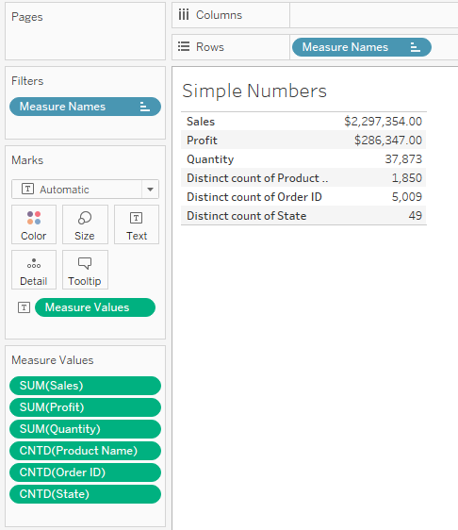
Simple Numbers
Gives you one row per measure in a table
Adds the values to the table
Perform a measure on each one. Count Distinct instead of Count to get the requested values.

Slide 10
Sales by State
Now that we know the data is correct, let’s build out a map of sales by state. Add some color so we can see higher sales at a glance. If you add the sales number as a label for each state (so we don’t have to mouse-over to see) that’d be a nice-to-have.

Slide 11
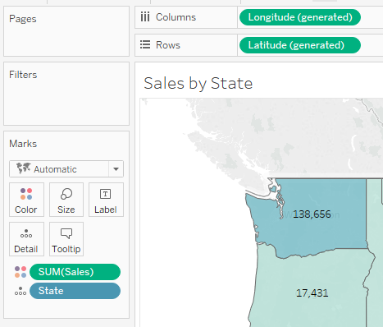
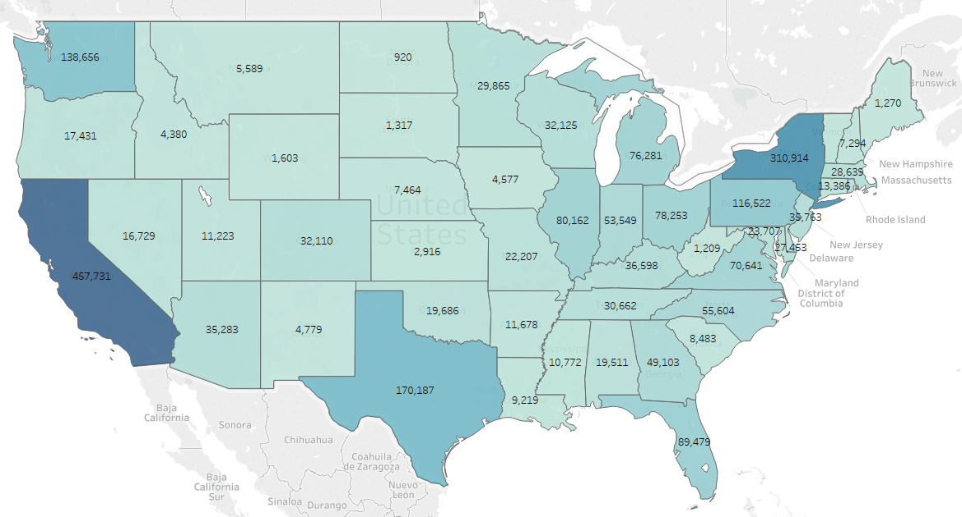
Sales By State
These are auto-generated by utilizing State
Click here and Check “Show Mark Labels” for numbers to appear
Finished Product
Dragging State into the large pane of the sheet produces this
Drag Sales over Color to color the graph based on Sales by State

Slide 12
Profit by State
While sales was helpful, what we really need is profit. Negative profit (I hear less-successful people call this ‘loss’) should be in a different color. Again, if possible, add the profit as a label. In a perfect world we’d also have the Rank Table Calculation for profit so we can quickly figure out our best and worst states.

Slide 13
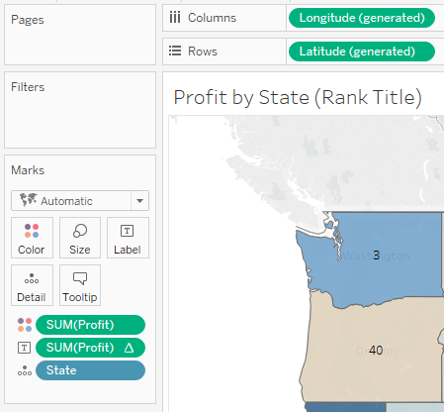
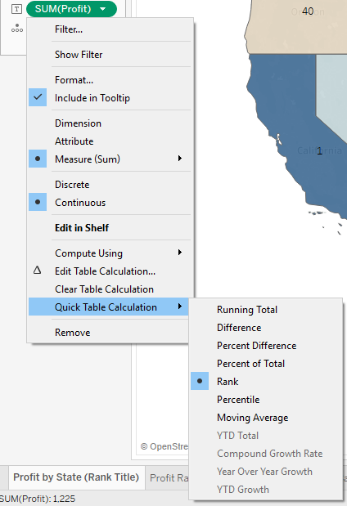
Profit By State
How to get Rank Table Calculation
Drag Profit onto Color and Label

Slide 14
Category Sales by Month
The category leaders are fighting each other on who has better sales in a specific month. I don’t want to pick a loser so can you build me a graphic? I also hate looking at tables so if you can turn it into an area graph that’d be great. Bonus points if you can get me Percent of Total for each Category by Month (so each month is 100% and split between the categories).

Slide 15
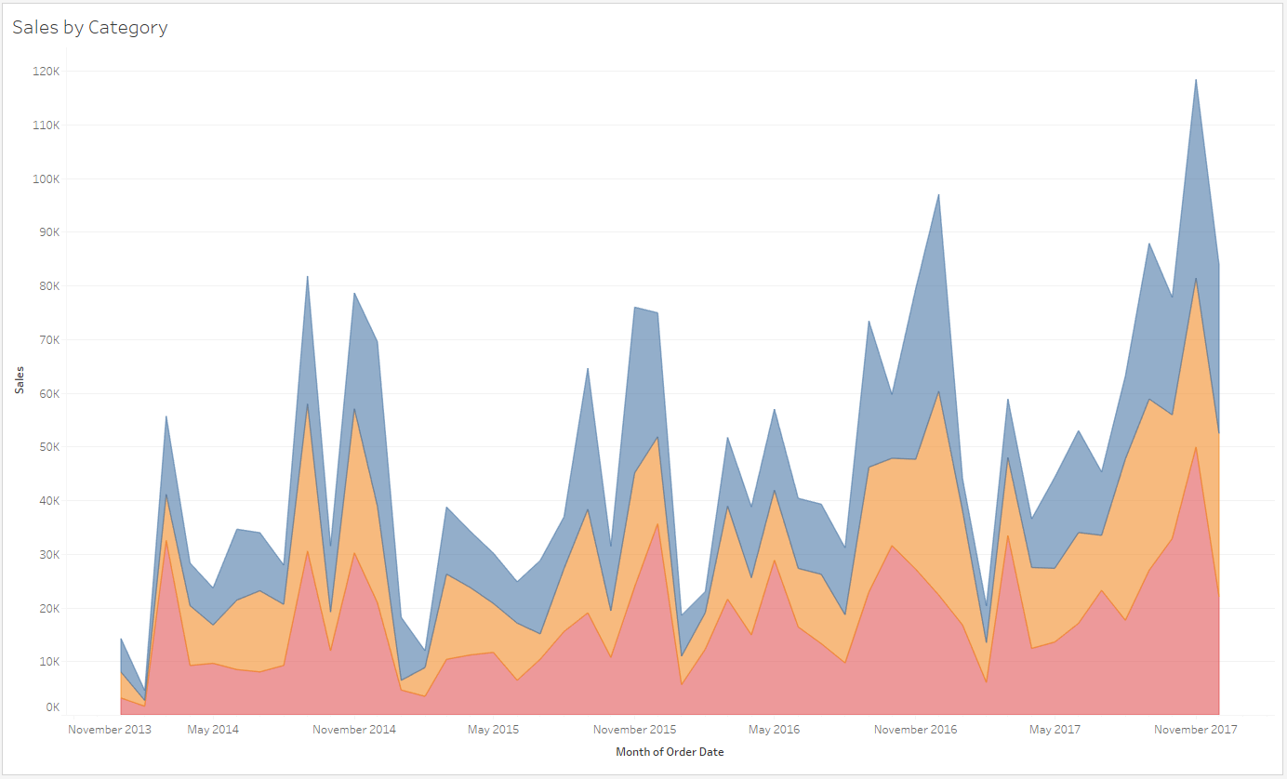
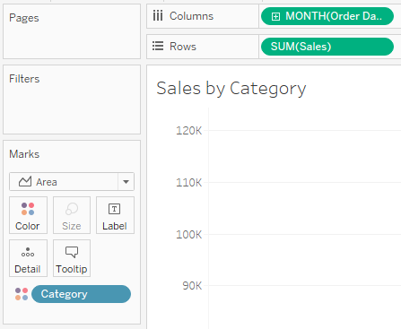
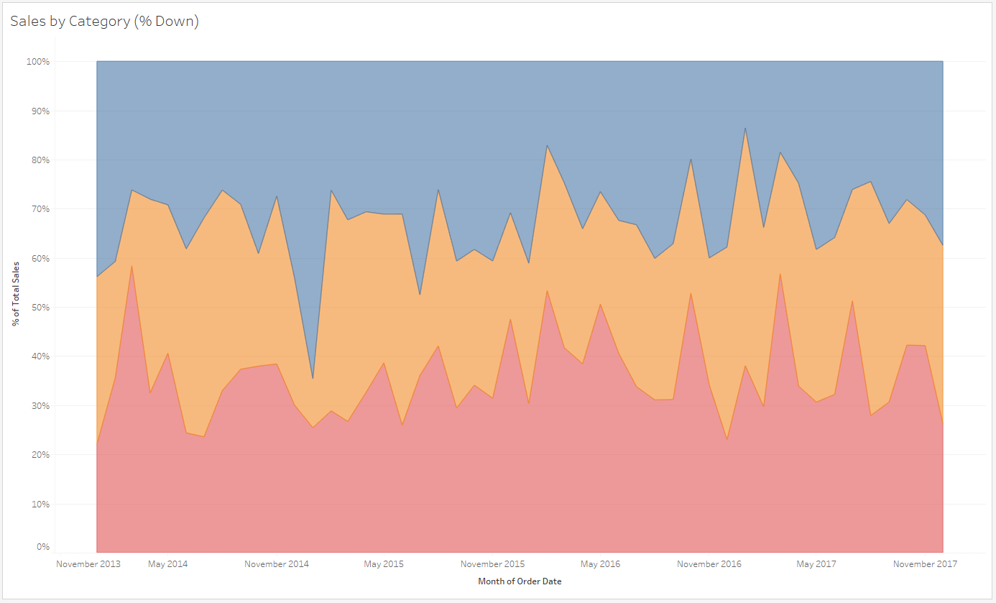
Category Sales by Month
Where the Pills should be placed

Slide 16
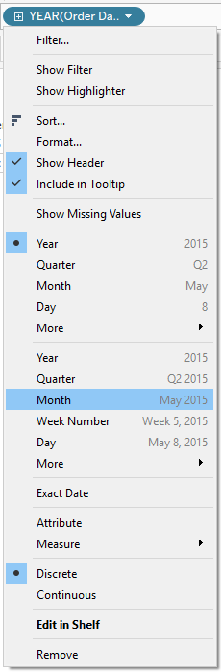
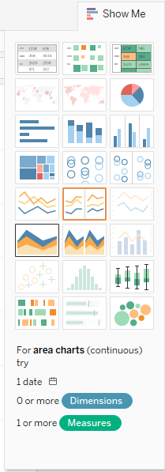
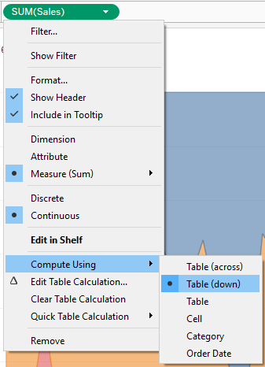
Category Sales by Month
Converting Blue Year to Green Month
(Discrete to Continuous)
Using “Show Me” to convert to Area Graph
“Table (down)” will produce the ‘Always 100%’ look we’re going for

Slide 17
Running total of Profit by Segment
The segment leaders realized the category leader fight improved morale, so they’ve started fighting each other on who has sold the most. They only care about lifetime profit though instead of monthly sales (they’re smarter). Who’s right? A line graph by month should work best.

Slide 18
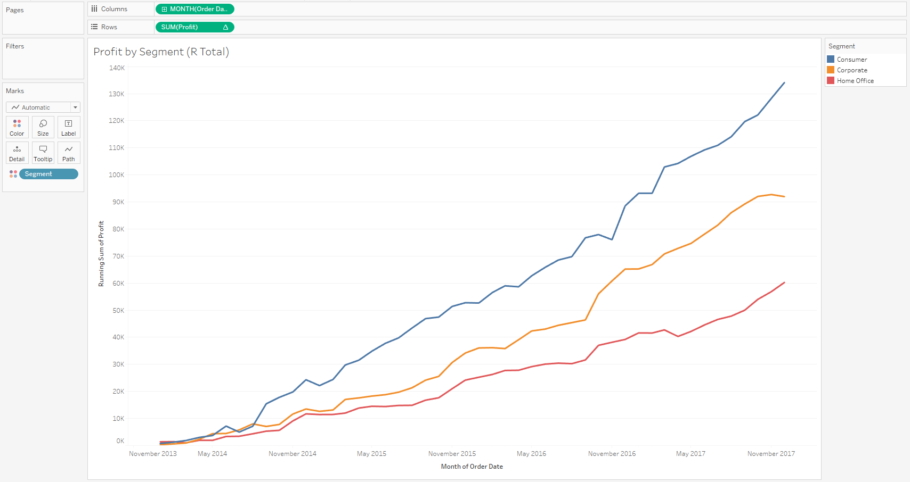
Running Total of Profit by Segment

Slide 19
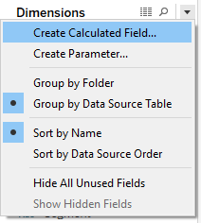
Profit Ratio by Sub-Category and Ship Mode
The egg-heads in shipping think that Ship Mode has an impact on our Profit Ratio. I think the Sub-Category is way more critical. Can you show us who’s right? If you can add the Category (to help group Sub-Categories) and include Row Totals and Column Totals that’ll help but isn’t necessary.
How to create a Calculated Field
Profit Ratio: SUM([Profit]) / SUM([Sales])

Slide 20
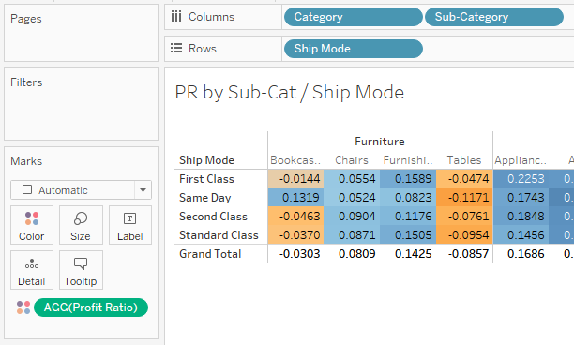
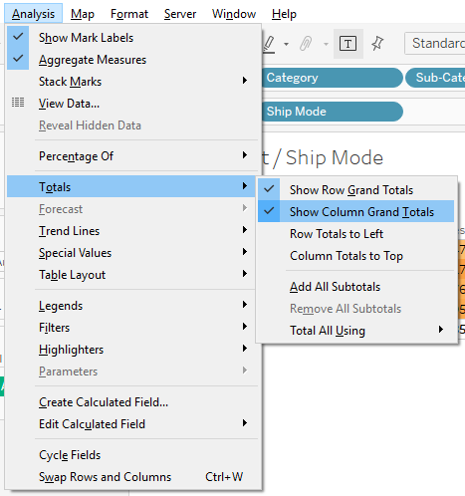
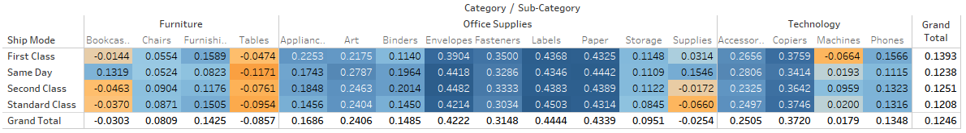
Profit Ratio by sub-category and ship mode
Pill Locations
How to get Row / Column Totals
Finished Product

Slide 21
Customer’s Sales, Profit Ratio, and Quantity
I heard some customers are getting sweet deals and messing with our Profit Ratios. I’m curious to un-cover a lot about Customers in a single graph. Ideally, I’m looking for a graph that showcases Sales vs. Profit Ratio per Customer, that also shows Quantity in some way. This way we can try and find customers that we seem to keep losing profit on. I think scatterplots, color, and shape will help here. Bonus points if you can modify the ToolTip to be more friendly than just listing the values.
Profit Ratio: SUM([Profit]) / SUM([Sales])

Slide 22
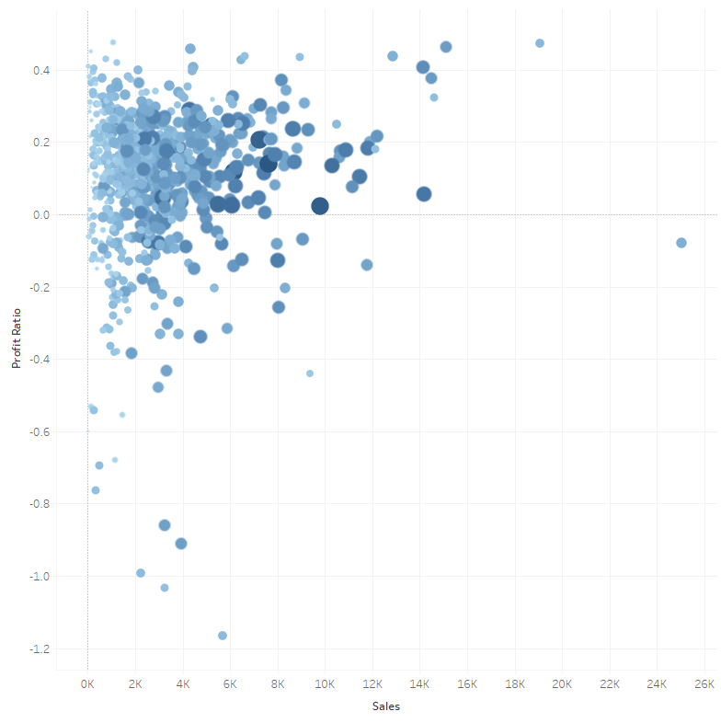
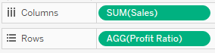
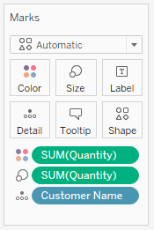
Customer’s Sales, Profit Ratio, and Quantity

Slide 23
Customer Order Details
After the results from the previous graph, people are going to want to be able to see the order details of a specific customer. Let’s build out a table that gives all the details for all the orders for a specific customer.
Hint: Using Filter will help cut down the data you show to a specific scope.
Bonus points for adding the customer’s name to the Sheet Title.

Slide 24
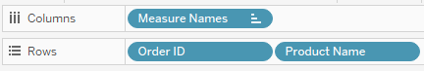
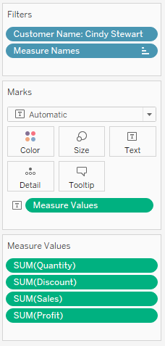
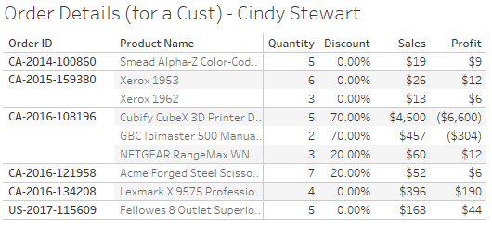
Customer order details

Slide 25
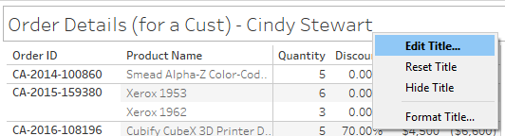
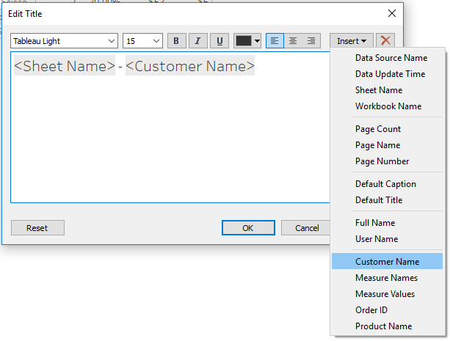
Customer order details

Slide 26
Dashboard time
Now that we have a bunch of sheets, let’s build some dashboards so individuals don’t have to go to each sheet one by one.
Bonus points for adding new sheets, using certain sheets as filters for others, adding KPIs, and branding.

Slide 27
SEC
#
How can I use this at a client?
Or did I just sit through this for nothing?

Slide 28
How Can you continue doing Data Viz?
At a client
Get a Tableau Desktop License
More data connection options available
Can save locally (Tableau Public forces the data to be public)
Use Alternative Tools
Alternative Tools
Power BI
Microsoft competitor to Tableau
Boom Lab Contacts: Sean Mitchell & Nate Kopacek
http://powerbi.com
D3.js
Open sourced browser visualizations
Used by FiveThirtyEight
https://d3js.org/
Matplotlib, Pandas, and Python
Open sourced scripting language and visualizations
Highly utilized by Data Analysts & Scientists
Boom Lab Contacts: Alex Sorenson & SDC
https://matplotlib.org/
https://pandas.pydata.org/

